Slide 1
K-MEANS clustering
Kuliah metode kuantitatif
Aziz kustiyo
Departemen ilmu komputer fmipa ipb

Slide 2
Introduction (1)
Nonhierarchical clustering tehniques are designed to group items, rather than variables, into a collection of K cluster
The number of cluster K, may either be specified in advance or or determined as part of the clustering procedure
Nonhierarchical clustering = partitional clustering

Slide 3
Introduction (2)
Nonhierarchical methods start from either
An initial partition of item into groups
An initial seed points, which will form the nuclei of clusters
One way to start is to randomly select seed point from among the items or to randomly partition the item into initial groups

Slide 4
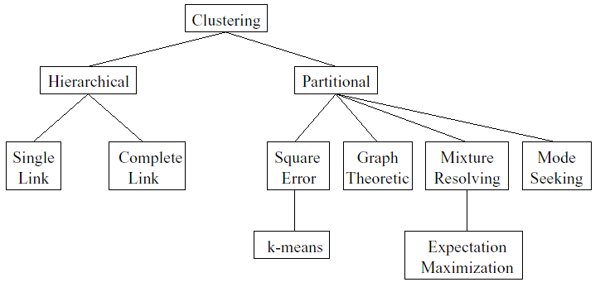
Taxonomy of Clustering Approaches
Notes:
A partitional clustering algorithm obtains a single partitioning of the data instead of a clustering structure such as the dendogram produced by hierachical algorithms

Slide 5
K-Means method (1)
Step 0: Start with a random partition into K clusters
Step 1: Generate a new partition by assigning each pattern to its closest cluster center
Step 2: Compute new cluster centers as the centroids of the clusters.
Step 3: Steps 1 and 2 are repeated until there is no change in the membership (also cluster centers remain the same)

Slide 6
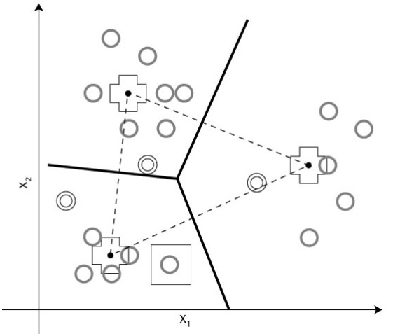
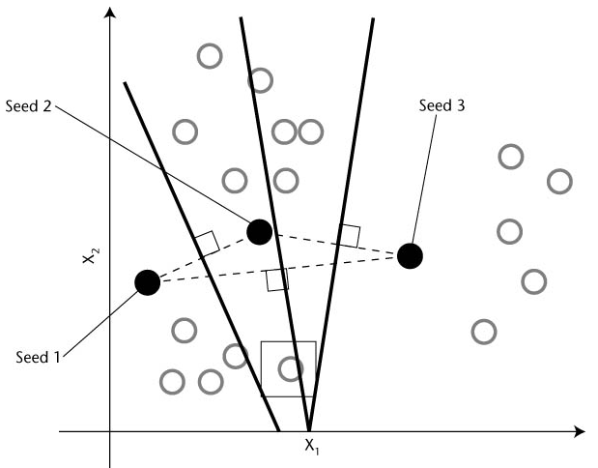
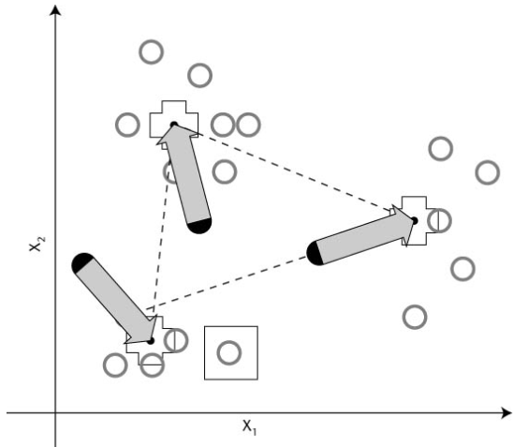
K-Means method (2)

Slide 7
K-means example (1)
Suppose that we measure 2 variables X1 and X2 for each 4 items A, B,C and D. The data are
A(5,3)
B(-1,1)
C(1,-2)
D(-3,-2)
The objective is to divide these items into K=2 clusters.

Slide 8
K-means example (2)
To implement K=2-means method,
we arbitrarily partition the items into two clusters, such (AB) and (CD)
compute the coordinates of the cluster centroid (mean)
AB→ (5 – 1)/2 = 2 and (3 + 1)/2= 2 → (2,2)
CD→ (1 – 3)/2 = -1 and (-2 – 2)/2=-2→ (-1,-2)

Slide 9
K-means example (3)
We compute the squared distance
d^2(A,(AB)) = (5-2)^2 + (3-2)^2 = 10
d^2(A,(CD)) = 61
d^2(B,(AB)) = 10
d^2(B,(CD)) = 9 → B reassigned to (CD) giving
cluster (BCD)

Slide 10
K-means example (4)
compute the coordinates of the new cluster centroid
A → (5,3)
BCD → (-1,-1)
We compute the squared distance
d^2(A,(A)) = 0 d^2(C,(A)) = 41
d^2(A,(BCD)) = 52 d^2(C,(BCD)) = 5
d^2(B,(A)) = 40 d^2(D,(A)) = 89
d^2(B,(BCD)) = 4 d^2(D,(BCD)) = 5
The final K=2 cluster are A and (BCD)

Slide 11
K-means example (5)
To check the stability of the clustering, it is desirable to rerun the algorithm with a new initial partition
Once clusters are determined, intuitions concerning their interpretations are aided by rearranging the list of items so that those in the first cluster appear first,...
A table of the cluster centroids (means) and within-cluster variances also help to delineate group difference

Slide 12
Final comments
There are strong argumen for not fixing the number of cluster K, in advance. These include the following:
1. if 2 or more seed points inadvertenly lie within a single cluster, their resulting clusters will be poorly differentiated
2. The existence of an outlier might produce at least one group with very disperse items
3. Sampling can reduce the number of groups in population

Slide 13
questions
The number of cluster K, may either be specified in advance → K-means
or determined as part of the clustering procedure → ???

Slide 14
Fuzzy C-Means Clustering
Fuzzy c-means (FCM) is a data clustering technique wherein each data point belongs to a cluster to some degree that is specified by a membership grade.
This technique was originally introduced by Jim Bezdek in 1981 [Bez81] as an improvement on earlier clustering methods.
It provides a method that shows how to group data points that populate some multidimensional space into a specific number of different clusters. (fuzzy toolbox)

Slide 15
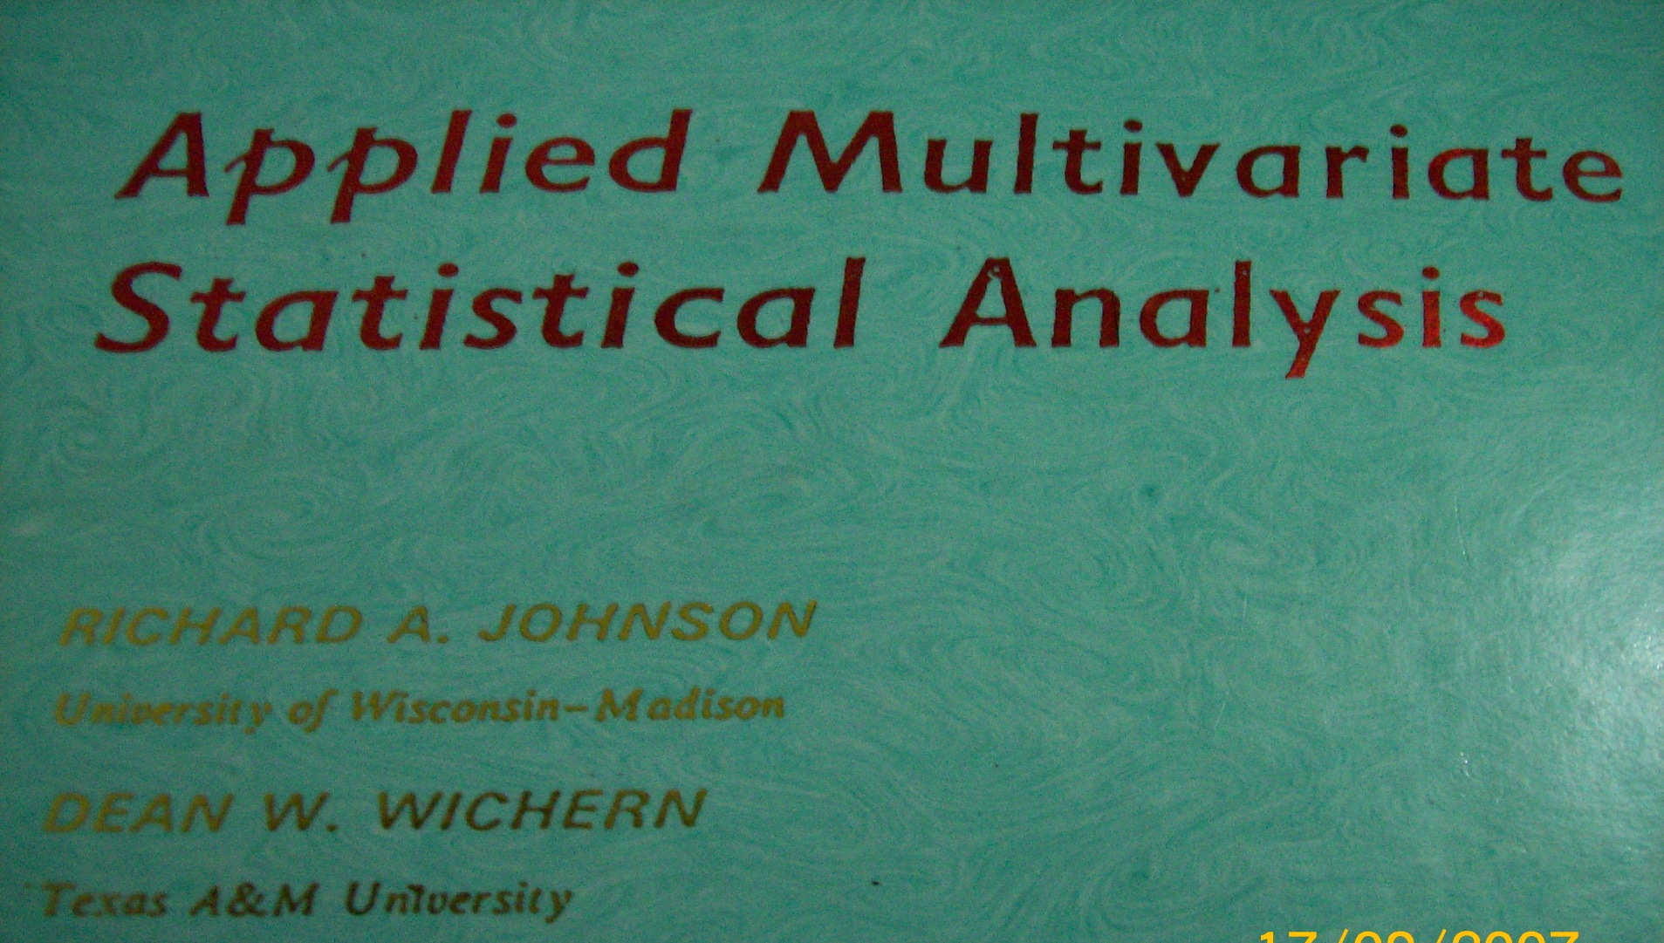
reference

Slide 16
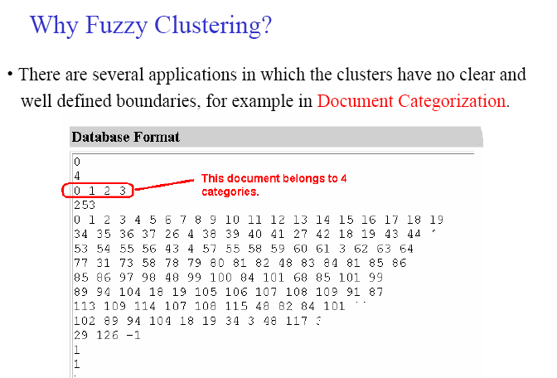
Fuzzy c-means

Slide 17
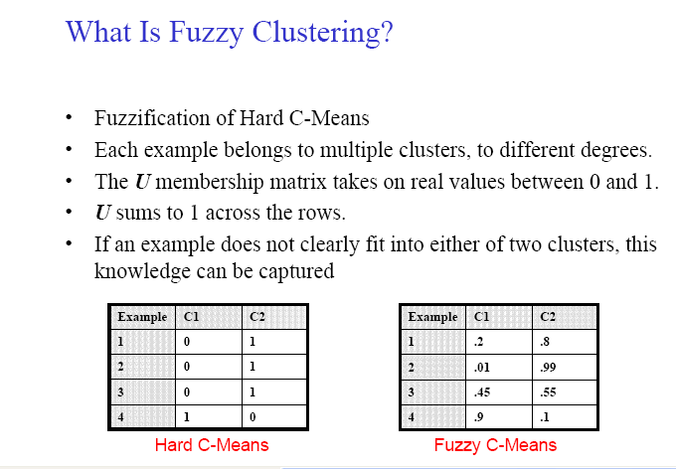

Slide 18
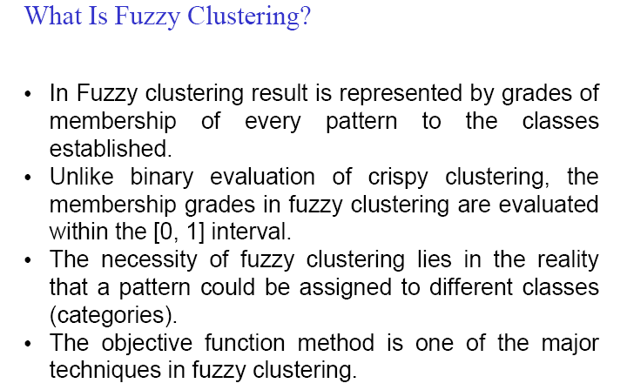

Slide 19
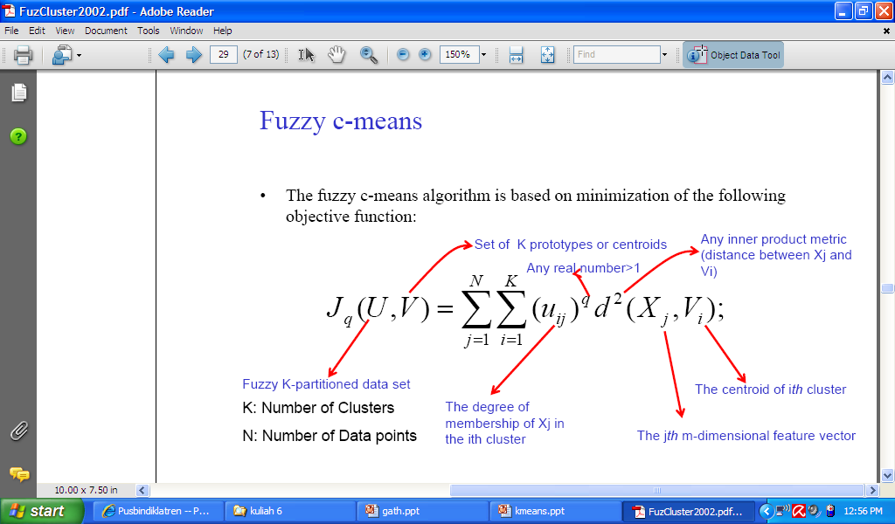

Slide 20
The Fuzzy k-Means Algorithm
N – the number of feature vectors
K – the number of clusters (partitions)
q – weighting exponent (fuzzifier; q > 1)
u_{ik} – the ith membership function
on the kth vector ( u_{ik}: X → [0,1] )
Σ_{k}u_{ik} = 1; 0 < Σ_{i}u_{ik} < n
V_{i}– the cluster prototype (the mean of all
feature vectors in cluster i or the
center of cluster i)
J_{q}(U,V) – the objective function

Slide 21
The Fuzzy k-Means Algorithm
Partition a set of feature vectors X
into K clusters (subgroups) represented as fuzzy sets F₁, F₂, …, F_{K}
by minimizing the objective function J_{q}(U,V)
J_{q}(U,V) = Σ_{i}Σ_{k}(u_{ik})^{q}d²(X_{j} – V_{i}); K ≤ N
Larger membership values indicate higher confidence in the assignment of the pattern to the cluster.

Slide 22
Description of Fuzzy Partitioning
Choose primary cluster prototypes V_{i}
for the values of the memberships
Compute the degree of membership of
all feature vectors in all clusters:
u_{ij} = [1/d²(X_{j} – V_{i})]^{1/(q-1)} / Σ_{k} [1/ d²(X_{j} – V_{i})]^{1/(q-1)} (1)
under the constraint: Σ_{i}u_{ik} = 1

Slide 23
Description of Fuzzy Partitioning
Compute new cluster prototypes V_{i}
V_{i} = Σ_{j}[(u_{ij})^{q} X_{j} ] / Σ_{j}(u_{ij})^{q} (2)
Iterate back and force between (1) and (2)
until the memberships or cluster centers
for successive iteration differ by more than
some prescribed value ε (a termination
criterion)

Slide 24
pustaka
Dari berbagai sumber

